Slide 1

CSE 445: Machine Learning
MDP and Reinforcement Learning
Instructor: Syed Athar Bin Amir, North South University
*partially modified from CS188 Berkeley

Slide 2
Reinforcement Learning
Agent
State: s
Reward: r
Actions: a
Environment
Basic idea:
Receive feedback in the form of rewards
Agent’s utility is defined by the reward function
Must (learn to) act so as to maximize expected rewards
All learning is based on observed samples of outcomes!
Notes:
Show robot-soccer learning to walk videos (UT Austin):
? Show snake robot:

Slide 3
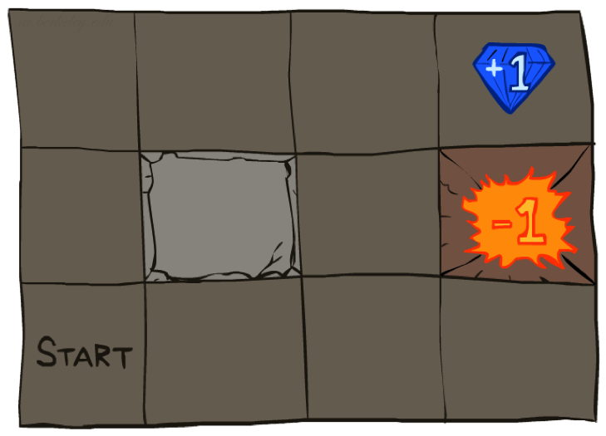




Example: Grid World
A maze-like problem
The agent lives in a grid
Walls block the agent’s path
Noisy movement: actions do not always go as planned
80% of the time, the action North takes the agent North (if there is no wall there)
10% of the time, North takes the agent West; 10% East
If there is a wall in the direction the agent would have been taken, the agent stays put
The agent receives rewards each time step
Small “living” reward each step (can be negative)
Big rewards come at the end (good or bad)
Goal: maximize sum of rewards
Notes:
[cut demo of moving around in grid world program]
Terminal utilities + living reward (positive – get happier; neg – get sadder)
At exist state you have to exit, the game ends, and you collect terminal utility
Don’t need to have goals – maximize happiness!

Slide 4
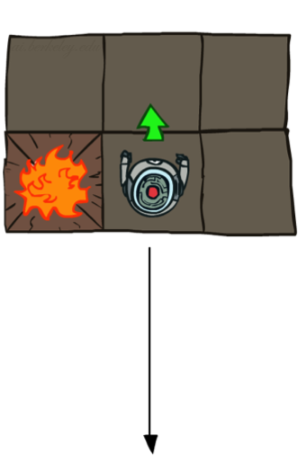
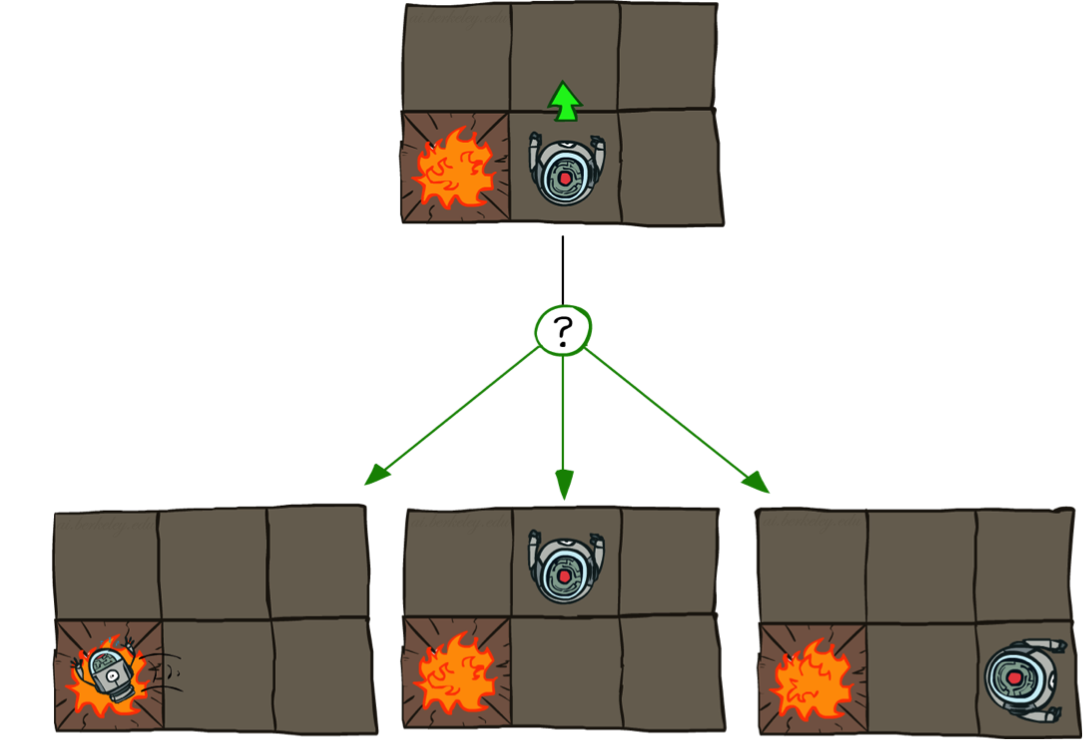
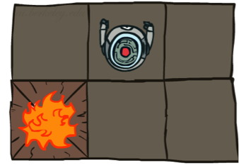
Grid World Actions
Deterministic Grid World
Stochastic Grid World

Slide 5
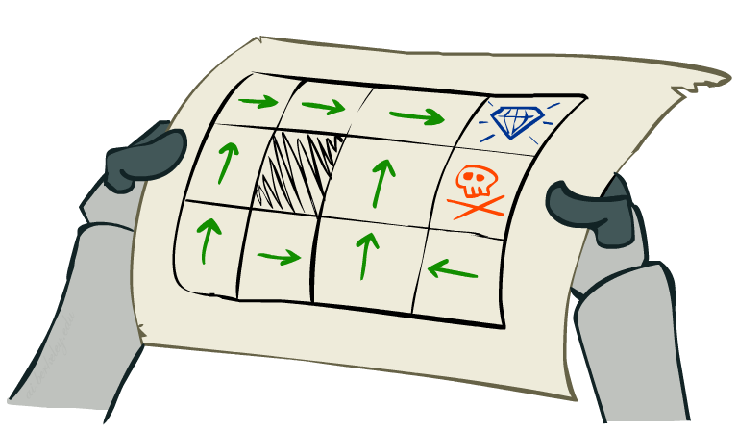
Markov Decision Processes
An MDP is defined by:
A set of states s ∈ S
A set of actions a ∈ A
A transition function T(s, a, s’)
Probability that a from s leads to s’, i.e., P(s’| s, a)
Also called the model or the dynamics
A reward function R(s, a, s’)
Sometimes just R(s) or R(s’)
A start state
Maybe a terminal state
MDPs are non-deterministic search problems
For MDPs, we want an optimal policy π*: S → A
A policy π gives an action for each state
An optimal policy is one that maximizes expected utility if followed
An explicit policy defines a reflex agent
Notes:
In search problems: did not talk about actions, but about successor functions --- now the information inside the successor function is unpacked into actions, transitions and reward
Write out S, A, example entry in T, entry in R
Reward function different from the book : R(s,a,s’)
In book simpler for equations, but not useful for the projects.
Need to modify expectimax a tiny little bit to account for rewards along the way, but that’s something you should be able to do, and so you can already solve MDP’s (not in most efficient way)

Slide 6
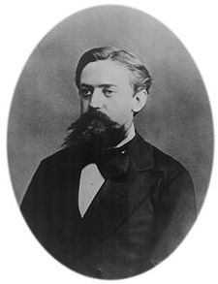

What is Markov about MDPs?
“Markov” generally means that given the present state, the future and the past are independent
For Markov decision processes, “Markov” means action outcomes depend only on the current state
Andrey Markov (1856-1922)
Notes:
Like search: successor function only depended on current state
Can make this happen by stuffing more into the state;
Very similar to search problems: when solving a maze with food pellets, we stored which food pellets were eaten

Slide 7

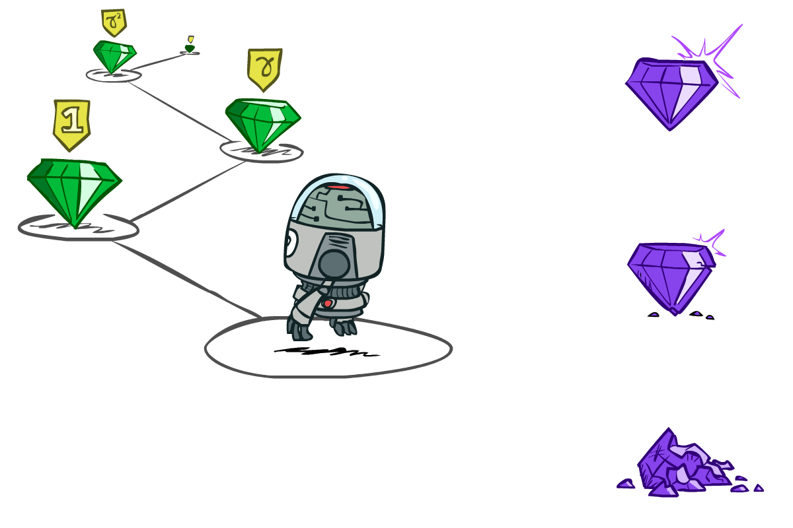

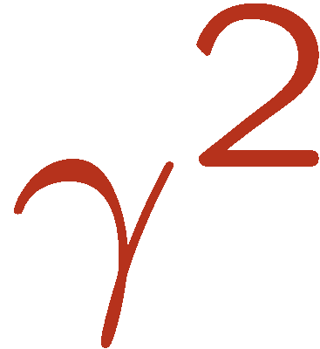

Discounting
It’s reasonable to maximize the sum of rewards
It’s also reasonable to prefer rewards now to rewards later
One solution: values of rewards decay exponentially
Worth Now
Worth Next Step
Worth In Two Steps
Notes:
Inflation; really there is (1-gamma) prob of dying

Slide 8
Optimal Quantities
The value (utility) of a state s:
V*(s) = expected utility starting in s and acting optimally
The value (utility) of a q-state (s,a):
Q*(s,a) = expected utility starting out having taken action a from state s and (thereafter) acting optimally
The optimal policy:
π*(s) = optimal action from state s
s
s is a state
a
(s, a) is a q-state
s, a
s,a,s’
(s,a,s’) is a transition
s’
Notes:
[Note: this demo doesn’t show anything in action, just pops up V and Q values.]

Slide 9

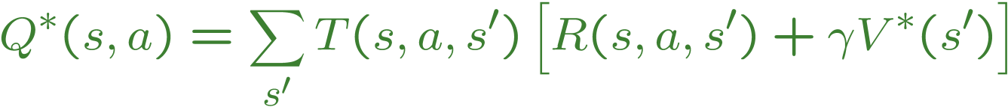
Values of States
Fundamental operation: compute the (expectimax) value of a state
Expected utility under optimal action
Average sum of (discounted) rewards
Recursive definition of value:
s
a
s, a
s,a,s’
s’

Slide 10


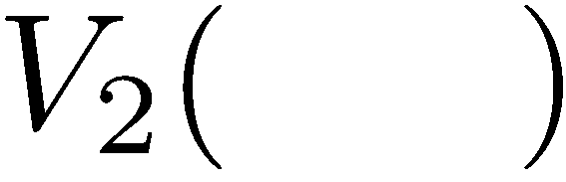


Time-Limited Values
Key idea: time-limited values
Define V_{k}(s) to be the optimal value of s if the game ends in k more time steps
Equivalently, it’s what a depth-k expectimax would give from s
Notes:
This demo generates the time-limited values for gridworld as snapshotted onto the next slides.

Slide 11
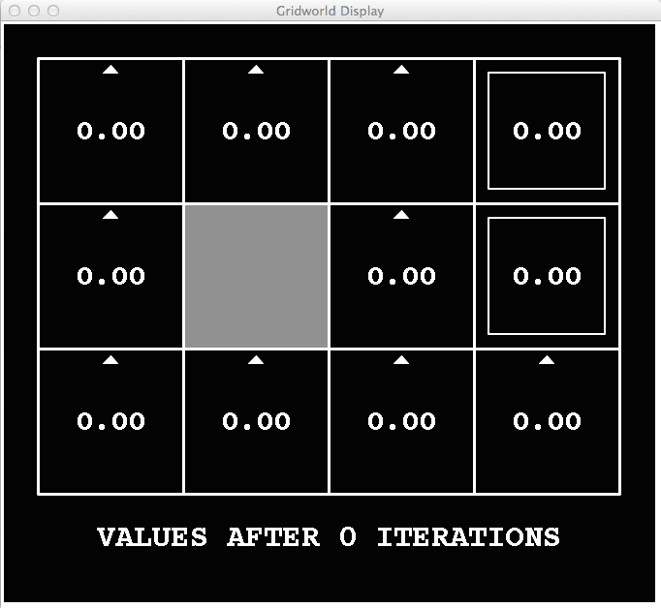
k=0
Noise = 0.2
Discount = 0.9
Living reward = 0
Notes:
Assuming zero living reward

Slide 12
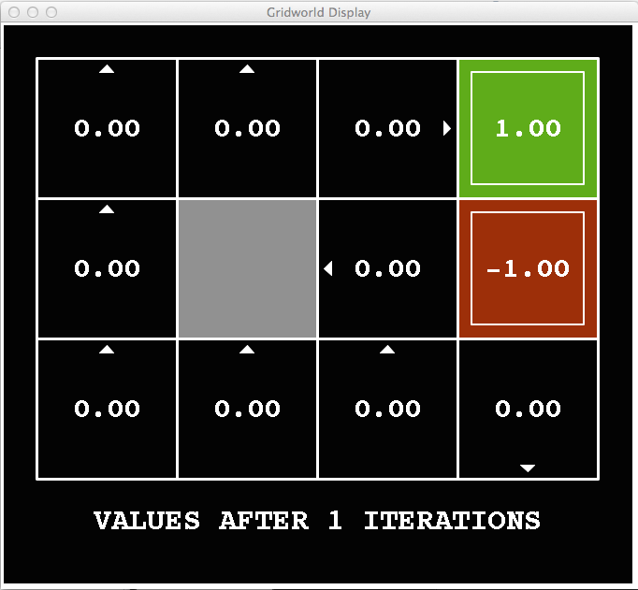
k=1
Noise = 0.2
Discount = 0.9
Living reward = 0
Notes:
Assuming zero living reward

Slide 13
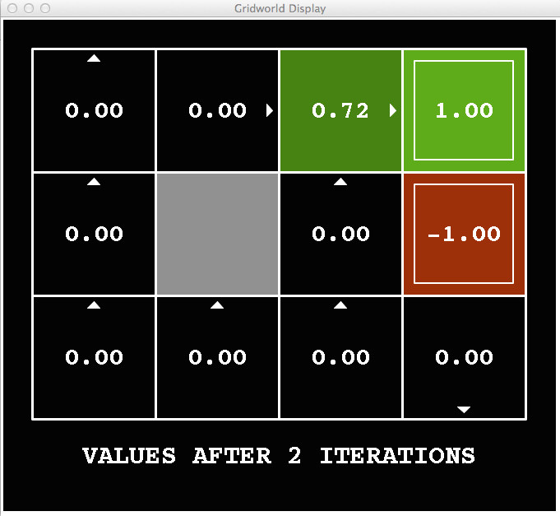
k=2
Noise = 0.2
Discount = 0.9
Living reward = 0
Notes:
Assuming zero living reward

Slide 14
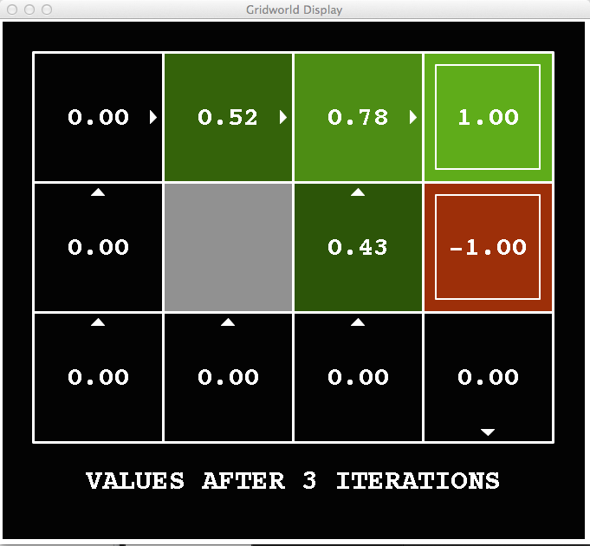
k=3
Noise = 0.2
Discount = 0.9
Living reward = 0
Notes:
Assuming zero living reward

Slide 15
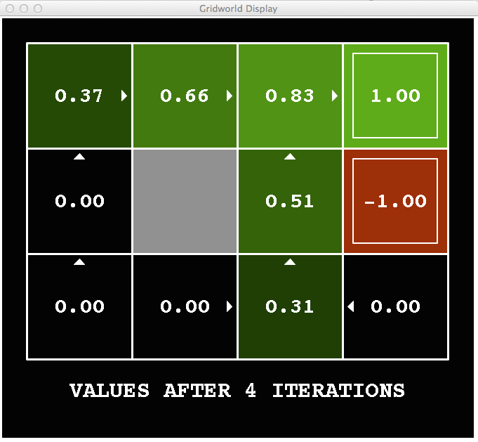
k=4
Noise = 0.2
Discount = 0.9
Living reward = 0
Notes:
Assuming zero living reward

Slide 16
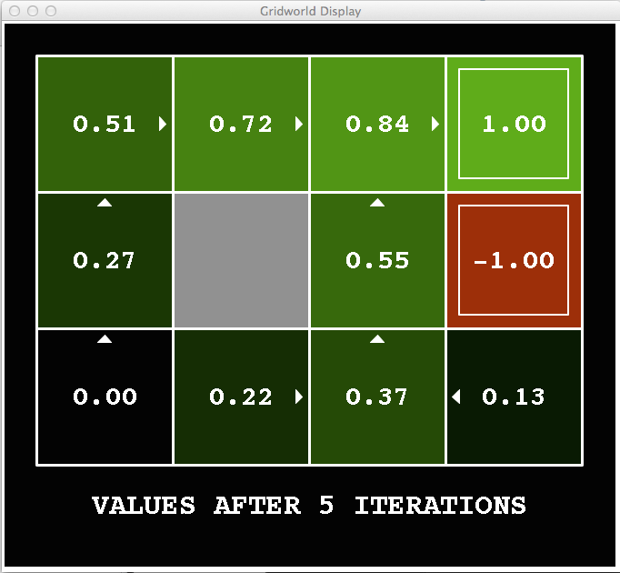
k=5
Noise = 0.2
Discount = 0.9
Living reward = 0
Notes:
Assuming zero living reward

Slide 17
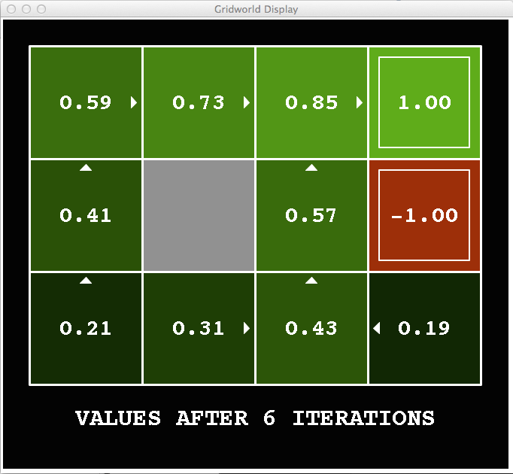
k=6
Noise = 0.2
Discount = 0.9
Living reward = 0
Notes:
Assuming zero living reward

Slide 18
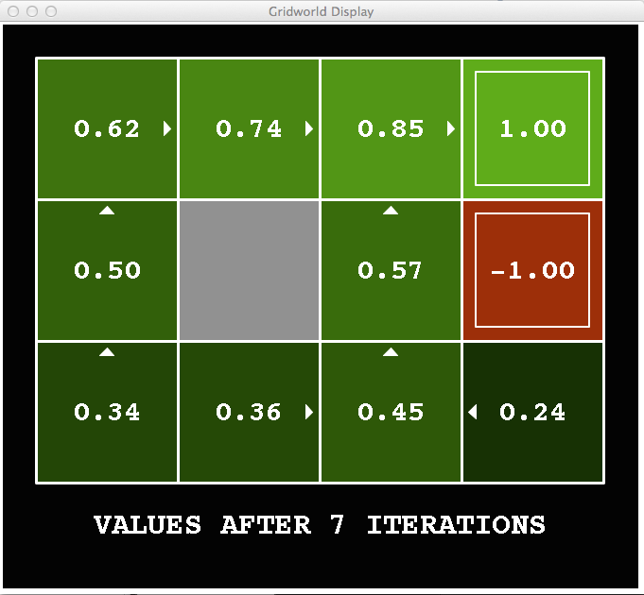
k=7
Noise = 0.2
Discount = 0.9
Living reward = 0
Notes:
Assuming zero living reward

Slide 19
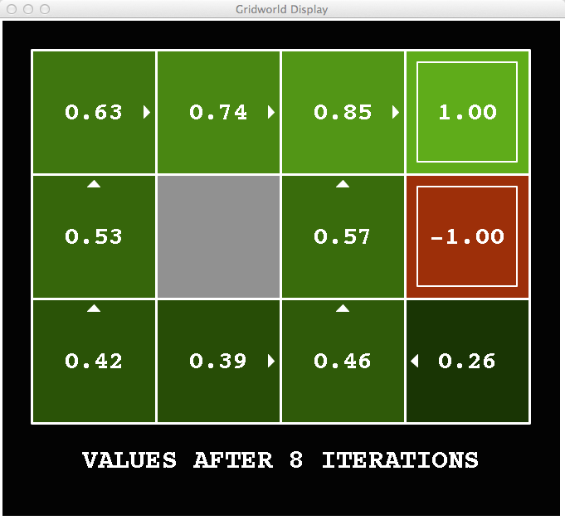
k=8
Noise = 0.2
Discount = 0.9
Living reward = 0
Notes:
Assuming zero living reward

Slide 20
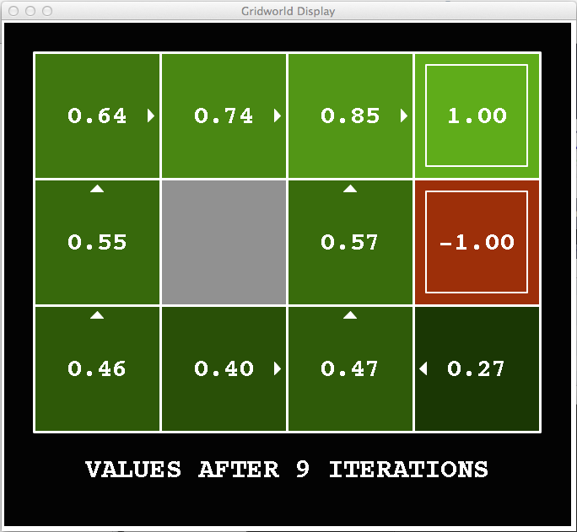
k=9
Noise = 0.2
Discount = 0.9
Living reward = 0
Notes:
Assuming zero living reward

Slide 21

k=10
Noise = 0.2
Discount = 0.9
Living reward = 0
Notes:
Assuming zero living reward

Slide 22

k=11
Noise = 0.2
Discount = 0.9
Living reward = 0
Notes:
Assuming zero living reward

Slide 23
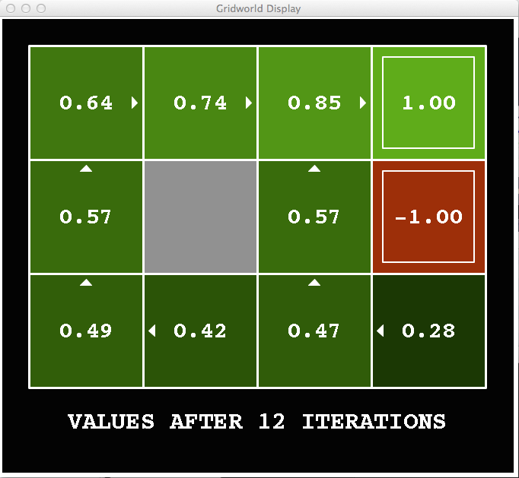
k=12
Noise = 0.2
Discount = 0.9
Living reward = 0
Notes:
Assuming zero living reward

Slide 24

k=100
Noise = 0.2
Discount = 0.9
Living reward = 0
Notes:
Assuming zero living reward

Slide 25
Value Iteration
Start with V₀(s) = 0: no time steps left means an expected reward sum of zero
Given vector of V_{k}(s) values, do one ply of expectimax from each state:
Repeat until convergence
Complexity of each iteration: O(S²A)
Theorem: will converge to unique optimal values
Basic idea: approximations get refined towards optimal values
Policy may converge long before values do
V_{k+1}(s)
a
s, a
s,a,s’
V_{k}(s’)
Notes:
Discuss computational complexity: S * A * S times number of iterations
Note: updates not in place [if in place, it means something else and not even clear what it means]

Slide 26



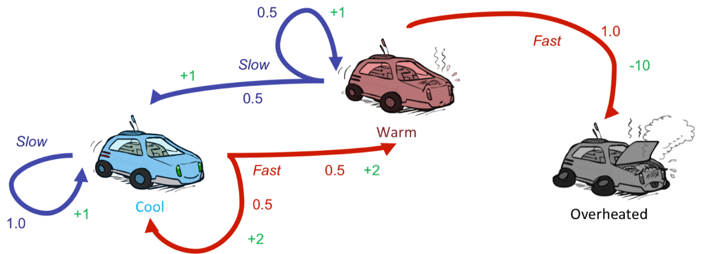
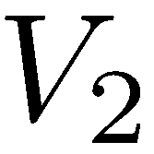
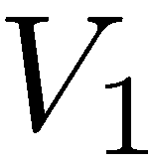
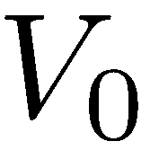
Example: Value Iteration
3.5 2.5 0
2 1 0
Assume no discount!
0 0 0
Notes:
Discuss computational complexity: S * A * S times number of iterations
Note: updates not in place [if in place, it means something else and not even clear what it means]

Slide 27
Problems with Value Iteration
Value iteration repeats the Bellman updates:
Problem 1: It’s slow – O(S²A) per iteration
Problem 2: The “max” at each state rarely changes
Problem 3: The policy often converges long before the values
s
a
s, a
s,a,s’
s’
Notes:
Demo steps through value iteration; snapshots of values shown on next slides.

Slide 28
Policy Iteration
Alternative approach for optimal values:
Step 1: Policy evaluation: calculate utilities for some fixed policy (not optimal utilities!) until convergence
Step 2: Policy improvement: update policy using one-step look-ahead with resulting converged (but not optimal!) utilities as future values
Repeat steps until policy converges
This is policy iteration
It’s still optimal!
Can converge (much) faster under some conditions

Slide 29
Policy Iteration
Evaluation: For fixed current policy π, find values with policy evaluation:
Iterate until values converge:
Improvement: For fixed values, get a better policy using policy extraction
One-step look-ahead:

Slide 30

Reinforcement Learning
Still assume a Markov decision process (MDP):
A set of states s ∈ S
A set of actions (per state) A
A model T(s,a,s’)
A reward function R(s,a,s’)
Still looking for a policy π(s)
New twist: don’t know T or R
I.e. we don’t know which states are good or what the actions do
Must actually try out actions and states to learn

Slide 31
Temporal Difference Learning
Big idea: learn from every experience!
Update V(s) each time we experience a transition (s, a, s’, r)
Likely outcomes s’ will contribute updates more often
Temporal difference learning of values
Policy still fixed, still doing evaluation!
Move values toward value of whatever successor occurs: running average
s
π(s)
s, π(s)
s’
Sample of V(s):
Update to V(s):
Same update:

Slide 32

Exponential Moving Average
Exponential moving average
The running interpolation update:
Makes recent samples more important:
Forgets about the past (distant past values were wrong anyway)
Decreasing learning rate (alpha) can give converging averages

Slide 33
Example: Temporal Difference Learning
States
Observed Transitions
B, east, C, -2
C, east, D, -2
 | A
B | C | D
 | E
 | 0
0 | 0 | 8
 | 0
 | 0
-1 | 0 | 8
 | 0
 | 0
-1 | 3 | 8
 | 0
Assume: γ = 1, α = 1/2

Slide 34
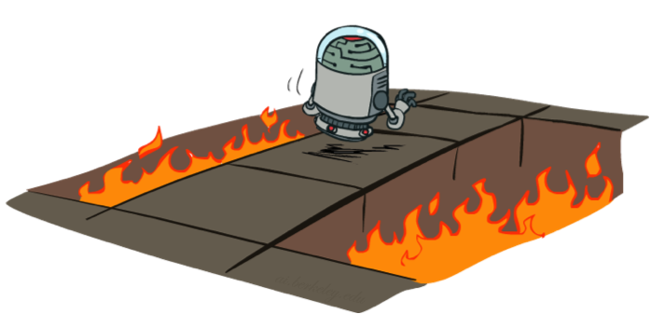
Active Reinforcement Learning
Full reinforcement learning: optimal policies (like value iteration)
You don’t know the transitions T(s,a,s’)
You don’t know the rewards R(s,a,s’)
You choose the actions now
Goal: learn the optimal policy / values
In this case:
Learner makes choices!
Fundamental tradeoff: exploration vs. exploitation
This is NOT offline planning! You actually take actions in the world and find out what happens…

Slide 35
Detour: Q-Value Iteration
Value iteration: find successive (depth-limited) values
Start with V₀(s) = 0, which we know is right
Given V_{k}, calculate the depth k+1 values for all states:
But Q-values are more useful, so compute them instead
Start with Q₀(s,a) = 0, which we know is right
Given Q_{k}, calculate the depth k+1 q-values for all q-states:

Slide 36

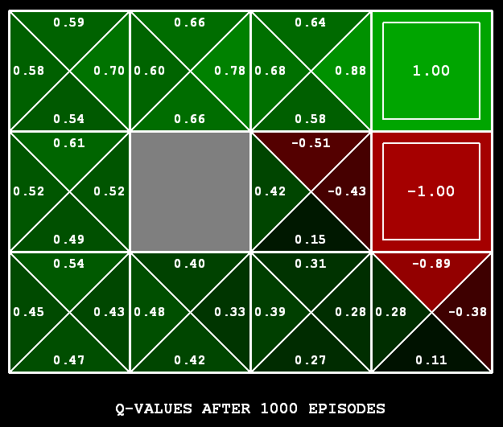
Q-Learning
Q-Learning: sample-based Q-value iteration
Learn Q(s,a) values as you go
Receive a sample (s,a,s’,r)
Consider your old estimate:
Consider your new sample estimate:
Incorporate the new estimate into a running average:

Slide 37

Q-Learning Properties
Amazing result: Q-learning converges to optimal policy -- even if you’re acting suboptimally!
This is called off-policy learning
Caveats:
You have to explore enough
You have to eventually make the learning rate
small enough
… but not decrease it too quickly
Basically, in the limit, it doesn’t matter how you select actions (!)
[Demo: Q-learning – auto – cliff grid (L11D1)]

Slide 38

How to Explore?
Several schemes for forcing exploration
Simplest: random actions (ε-greedy)
Every time step, flip a coin
With (small) probability ε, act randomly
With (large) probability 1-ε, act on current policy
Problems with random actions?
You do eventually explore the space, but keep thrashing around once learning is done
One solution: lower ε over time
Another solution: exploration functions
[Demo: Q-learning – manual exploration – bridge grid (L11D2)] [Demo: Q-learning – epsilon-greedy -- crawler (L11D3)]

Slide 39
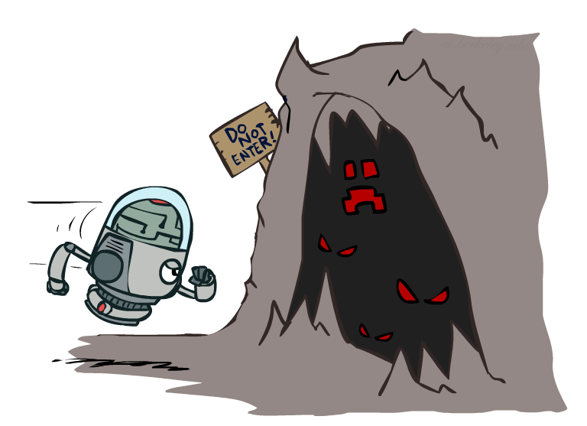

Exploration Functions
When to explore?
Random actions: explore a fixed amount
Better idea: explore areas whose badness is not
(yet) established, eventually stop exploring
Exploration function
Takes a value estimate u and a visit count n, and
returns an optimistic utility, e.g.
Note: this propagates the “bonus” back to states that lead to unknown states as well!
Regular Q-Update:
Modified Q-Update:
[Demo: exploration – Q-learning – crawler – exploration function (L11D4)]

Slide 40


Generalizing Across States
Basic Q-Learning keeps a table of all q-values
In realistic situations, we cannot possibly learn about every single state!
Too many states to visit them all in training
Too many states to hold the q-tables in memory
Instead, we want to generalize:
Learn about some small number of training states from experience
Generalize that experience to new, similar situations
This is a fundamental idea in machine learning, and we’ll see it over and over again
[demo – RL pacman]

Slide 41
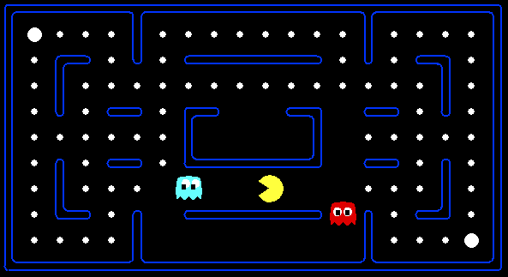



Feature-Based Representations
Solution: describe a state using a vector of features (properties)
Features are functions from states to real numbers (often 0/1) that capture important properties of the state
Example features:
Distance to closest ghost
Distance to closest dot
Number of ghosts
1 / (dist to dot)²
Is Pacman in a tunnel? (0/1)
…… etc.
Is it the exact state on this slide?
Can also describe a q-state (s, a) with features (e.g. action moves closer to food)

Slide 42
Linear Value Functions
Using a feature representation, we can write a q function (or value function) for any state using a few weights:
Advantage: our experience is summed up in a few powerful numbers
Disadvantage: states may share features but actually be very different in value!

Slide 43

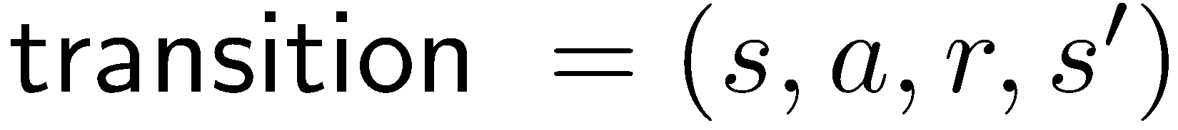
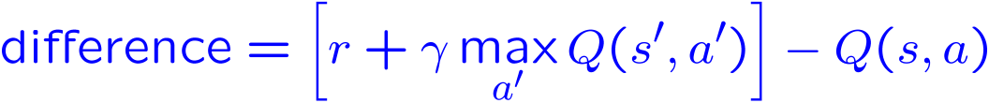
Approximate Q-Learning
Q-learning with linear Q-functions:
Intuitive interpretation:
Adjust weights of active features
E.g., if something unexpectedly bad happens, blame the features that were on: disprefer all states with that state’s features
Formal justification: online least squares
Exact Q’s
Approximate Q’s

Slide 44
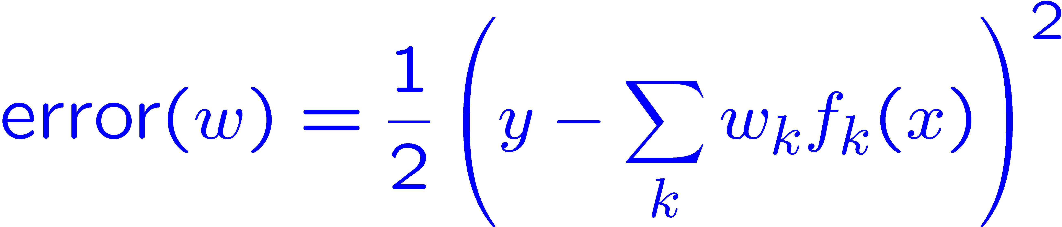
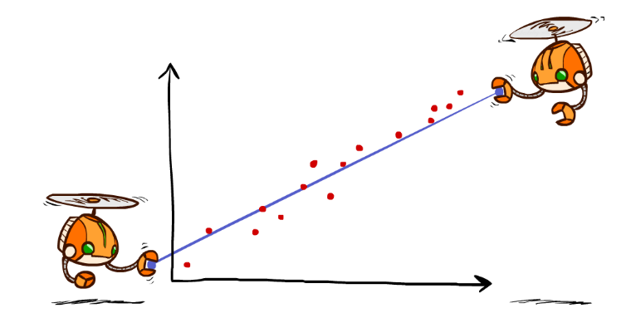
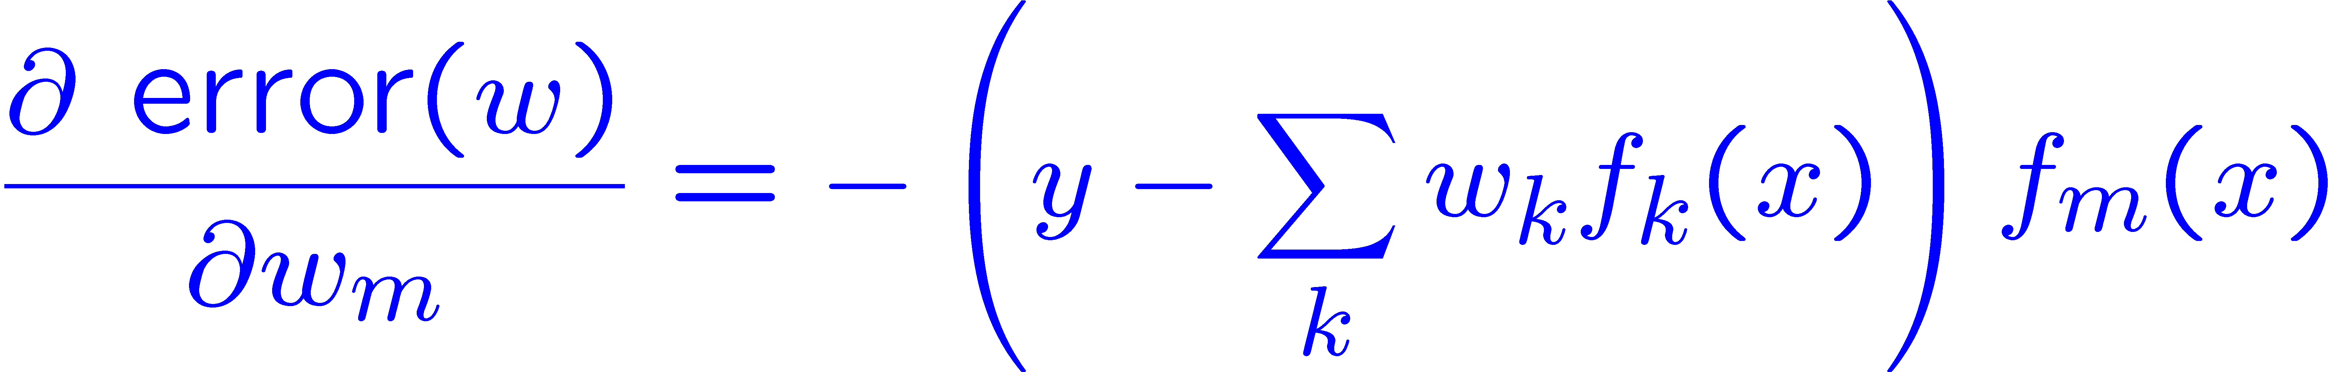
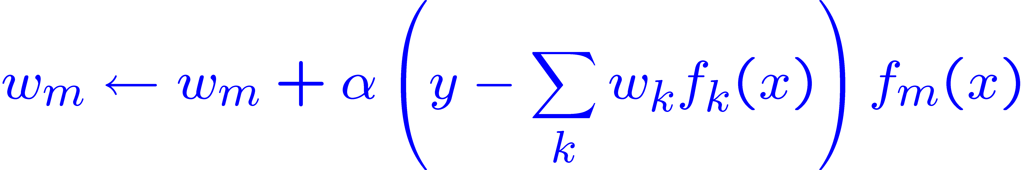
Minimizing Error
Imagine we had only one point x, with features f(x), target value y, and weights w:
Approximate q update explained:
“target”
“prediction”

Slide 45
More Powerful Function Approximation
Linear:
Polynomial:
Neural Network:
Learn These Too

